Slide 1
University of Mysore
Teresian College,
Siddartha Nagar,Mysuru
YRC UNIT

Slide 2
Activities for 2019-2020
1.Inauguration of youth red cross unit and orientation programme was held on 01.02.2020, at 11am at Zoology lab, in Teresian college, Mysore.80 students were present.
Objective:-
Awareness about YRC and its activities.
Out come;-
More knowledge gained by YRC students.

Slide 3
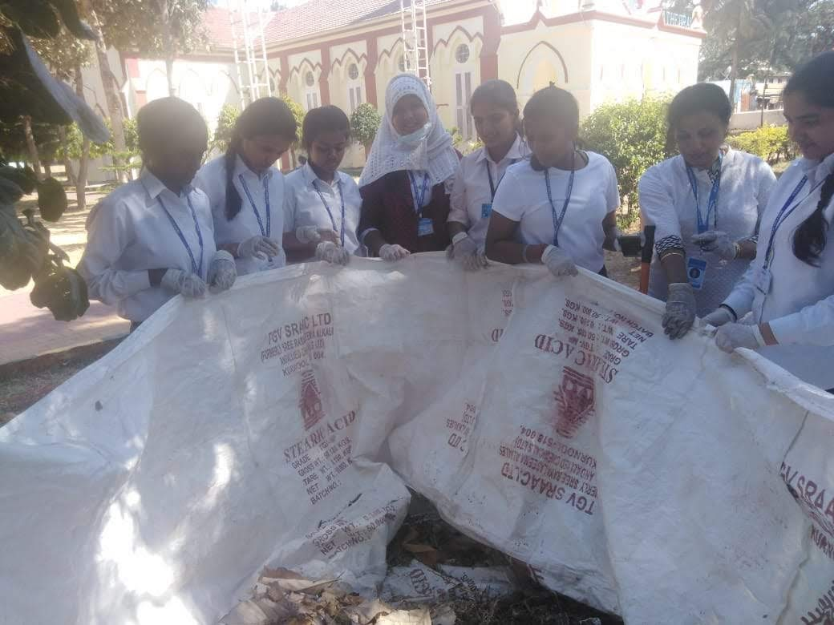
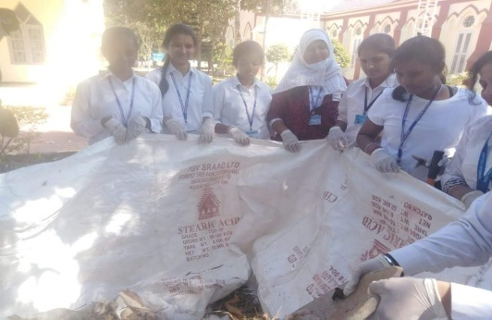
2.Css wesley church campus cleaning
A cleaning program was conducted by Youth Red Cross Unit of Teresian college Mysore on 17.02.2020 at the CSS Wesley church campus, Mysore. It started at 2pm and extended till 5pm.There were 10 volunteers present including the programme officer.
Objectives;-Swachh Bharth Abhiyaan Scheme in cleaning the church campus.
Out come:-
This initiative has given the required impetus to enable cleaning
and hygiene practices not only in the Church but in and around
the location.

Slide 4
3.National Deworming Day
On account of Deworming Day on 10.02.2020, 280 tablets were distributed to 1st year BSc, B.com and B.A students on 19th February 2020.
Objective;-
Every year February 10 and August 10 are observed as the National Deworming Days(NDD).
The days aim at eradicating intestinal worms also known as Soil-Transmitted Helminths (STH), among children.
Outcomes;-
Decreases anaemia and improves nutrition. Increase and weight gain. Improves cognition and mental and physical development
.

Slide 5
.
THANK YOU
THANK YOU
THANK YOU

